Slide 1
What is philosophy of science?
social
Phil. sci. analyzes the
epistemic
practices of science
technical
Explaining things
Describing things
Predicting things
Formulating theories/models/hypotheses
Justifying/confirming/refuting theories/models/hypotheses
All these practices are affected by uncertainty!

Slide 2
Feynman on Scientific Uncertainty
Scientists, therefore, are used to dealing with doubt and uncertainty. All scientific knowledge is uncertain. This experience with doubt and uncertainty is important.
I believe that it is of very great value, and one that extends beyond the sciences. I believe that to solve any problem that has never been solved before, you have to leave the door to the unknown ajar. You have to permit the possibility that you do not have it exactly right. Otherwise, if you have made up your mind already, you might not solve it.

Slide 3
Feynman on Scientific Uncertainty (cont.)
So what we call scientific knowledge today is a body of statements of varying degrees of certainty.
Some of them are most unsure; some of them are nearly sure; but none is absolutely certain. Scientists are used to this. We know that it is consistent to be able to live and not know. Some people say, "How can you live without knowing?" I do not know what they mean. I always live without knowing. That is easy. How you get to know is what I want to know.

Slide 4
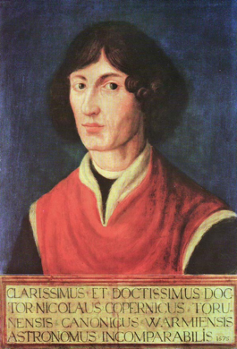
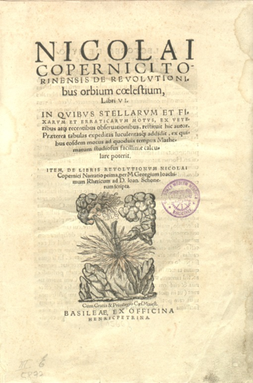
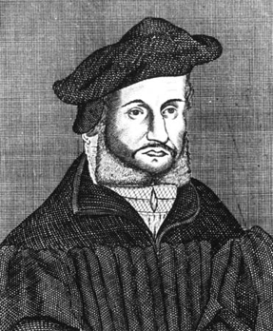
Osiander’s Foreword to
Copernicus’ De revolutionibus orbium coelestium (1543)
To the Reader Concerning the Hypotheses of this Work
There have already been widespread reports about the novel hypotheses of this work, which declares that the earth moves whereas the sun is at rest in the center of the universe. Hence certain scholars, I have no doubt, are deeply offended and believe that the liberal arts, which were established long ago on a sound basis, should not be thrown into confusion. But if these men are willing to examine the matter closely, they will find that the author of this work has done nothing blameworthy. For it is the duty of an astronomer to compose the history of the celestial motions through careful and expert study. Then he must conceive and devise the causes of these motions or hypotheses about them. Since he cannot in any way attain to the true causes, he will adopt whatever suppositions enable the motions to be computed correctly from the principles of geometry for the future as well as for the past. The present author has performed both these duties excellently. For these hypotheses need not be true nor even probable. On the contrary, if they provide a calculus consistent with the observations, that alone is enough.
Copernicus
1473 – 1543
Instrumentalism
Andreas Osiander
1498 – 1552

Slide 5
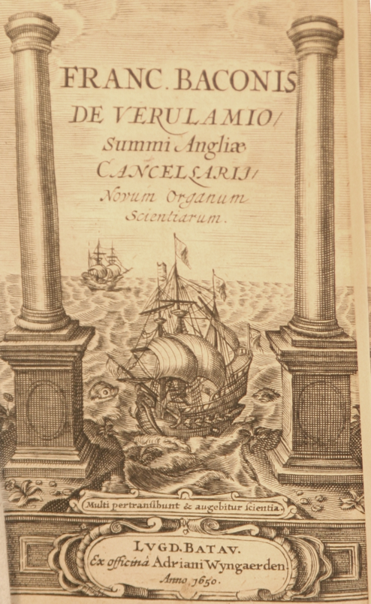
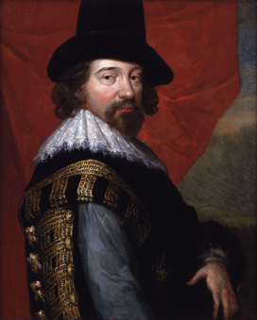
Francis Bacon’s Novum Organum (1620)
Francis Bacon
1561–1626
Title refers to Aristotle’s deductive logic in the Organon (the collection of logical works by Aristotle)
Rejection of purely deductive reasoning
Observation and induction as the method of science!
Foundation of empiricism
Science as a social process (Multi pertransibunt et scientia agebitur)
Aim: Common good

Slide 6
Types of Inferences
Deduction
All the beans in this bag are white
These beans are from this bag
-------------------------------------------------
These beans are white
Properties:
The truth of the premises warrants the truth of the conclusion.
In a deductively valid argument, it is impossible that the premises are true and the conclusion is false.
Logically necessary
Not ampliative
A deductive argument is called „sound“ if its premises happen to be true.
Induction
These beans are white
These beans are from this bag
-------------------------------------------------
All the beans in this bag are white
Properties:
The truth of the premises does not warrant the truth of the conclusion.
It is possible that the premises are true and the conclusion is false.
Not necessary
Ampliative
Abductive I.
(Peirce: „Hypothesis“)
All the beans in this bag are white
These beans are white
-------------------------------------------------
These beans are from this bag
Properties:
The truth of the premises does not warrant the truth of the conclusion.
It is possible that the premises are true and the conclusion is false.
Not necessary
Ampliative
The conclusion „explains“ the premises.
Inference to the best explanation
C. S. Peirce, Deduction, Induction, Hypothesis (1878)

Slide 7
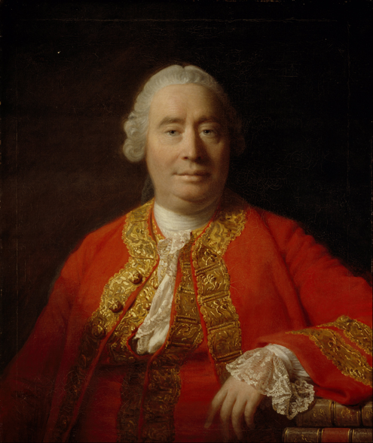
David Hume and the Problem of Induction
Reasoning that goes beyond past and present is based on cause and effect
The relation of causality:
1) constant conjunction
2) contiguity
3) priority in time (of the cause)
4) NO necessary connection!!!!
David Hume
1711–1776
The Problem of Induction
How can inferences from the past/present to the future (or from observed instances to unobserved instances) be justified?

Slide 8
Hume on Causality
„Here is a billiard-ball lying on the table, and another ball moving towards it with rapidity. They strike; and the ball, which was formerly at rest, now acquires a motion. This is as perfect an instance of the relation of cause and effect as any which we know, either by sensation or by reflection. Let us therefore examine it. ’Tis evident, that the two balls touched one another before the motion was communicated, and that there was no interval betwixt the shock and the motion. Contiguity in time and place is therefore a requisite circumstance to the operation of all causes. ’Tis evident likewise, that the motion, which was the cause, is prior to the motion, which was the effect. Priority in time, is therefore another requisite circumstance in every cause. But this is not all. Let us try any other balls of the same kind in a like situation, and we shall always find, that the impulse of the one produces motion in the other. Here therefore is a third circumstance, viz., that is a constant conjunction betwixt the cause and effect. Every object like the cause, produces always some object like the effect. Beyond these three circumstances of contiguity, priority, and constant conjunction, I can discover nothing in this cause. The first ball is in motion; touches the second; immediately the second is in motion: and when I try the experiment with the same or like balls, in the same or like circumstances, I find that upon the motion and touch of the one ball, motion always follows in the other. In whatever shape I turn this matter, and however I examine it, I can find nothing farther.“
(An Enquiry Concerning Human Understanding, Abstract of a Treatise of Human Nature)

Slide 9
Assignment:
Compare the following inferences:
All pieces of copper conduct electricity. Therefore, the next piece of copper that I will encounter will also conduct electricity.
All people in this room speak English and they all entered the room through the door. Therefore, the next person who enters the room through the door will also speak English.
What is the difference between the two inferences? Do not merely focus on the fact that the latter seems erroneous. Focus on the difference between the two all-sentences.
cf. Nelson Goodman, Nelson. Fact, Fiction, and Forecast (1954)

Slide 10
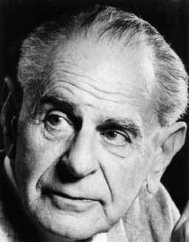
Karl Popper’s (Dis)solution of the Problem in
The Logic of Scientific Discovery (1934)
Karl R. Popper
1902–1964
The Hypothetico-Deductive Method/Falsificationism
“According to the view that will be put forward here, the method of critically testing theories, and selecting them according to the results of tests, always proceeds on the following lines. From a new idea, put up tentatively, and not yet justified in any way—an anticipation, a hypothesis, a theoretical system, or what you will—conclusions are drawn by means of logical deduction.”
I

Slide 11
Hypothetico-Deductive Method/Falsificationism (cont.)
“Next we seek a decision as regards these (and other) derived statements by comparing them with the results of practical applications and experiments. If this decision is positive, that is, if the singular conclusions turn out to be acceptable, or verified, then the theory has, for the time being, passed its test: we have found no reason to discard it. But if the decision is negative, or in other words, if the conclusions have been falsified , then their falsification also falsifies the theory from which they were logically deduced.”
II
“Nothing resembling inductive logic appears in the procedure here outlined. I never assume that we can argue from the truth of singular statements to the truth of theories. I never assume that by force of ‘verified’ conclusions, theories can be established as ‘true’, or even as merely ‘probable’.”

Slide 12
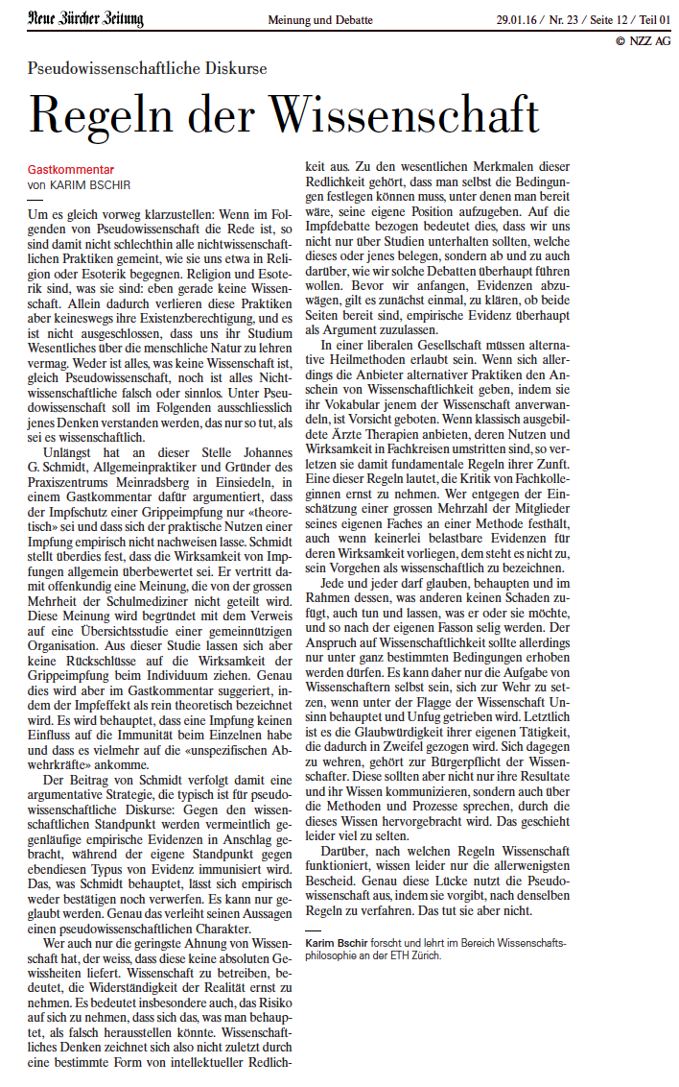
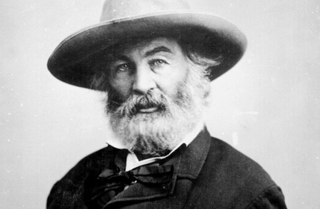
I like the scientific spirit—the holding off, the being sure but not too sure, the willingness to surrender ideas when the evidence is against them: this is ultimately fine—it always keeps the way beyond open—always gives life, thought, affection, the whole man, a chance to try over again after a mistake—after a wrong guess.
Walt Whitman

Slide 13
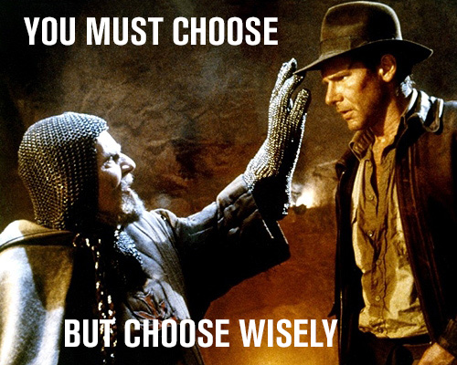
Hastie&Dawes: Rationality (pp. 16-17)
Technical Definition:
Rationality is the capacity to make good decisions.

Slide 14
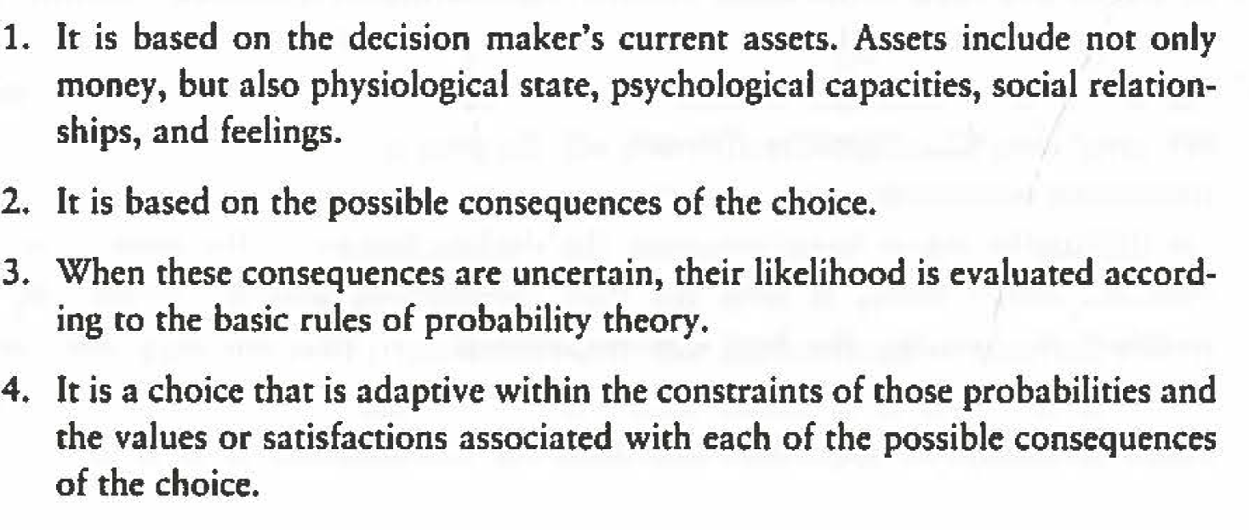
Hastie&Dawes: Rationality (pp. 16-17)
Def.: Rational Choice

Slide 15
Hastie&Dawes: Rationality (pp. 17-31)
Def. Expected Value:
Probability of the event x value of outcome
Def. Utility:
Value of outcome given personal preferences
Def. Expected Utility:
∑ (probability_{i} x utility_{i}) for each alternative course of action

Slide 16
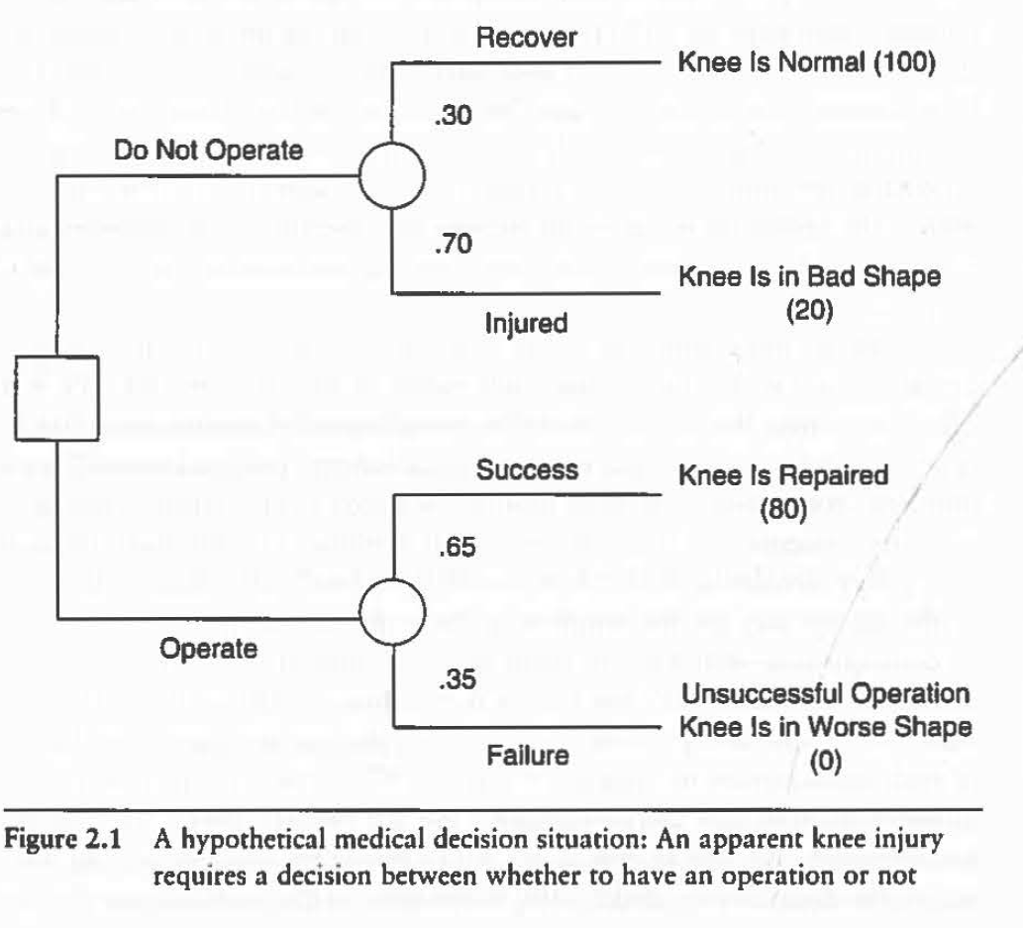
Hastie&Dawes: Rationality (pp. 28)

Slide 17
The Kolmogorov Axioms of Classical Probability Calculus
The axioms as such only define the formal properties of probability.
The notion of probability still needs to be interpreted!

Slide 18
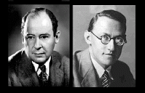
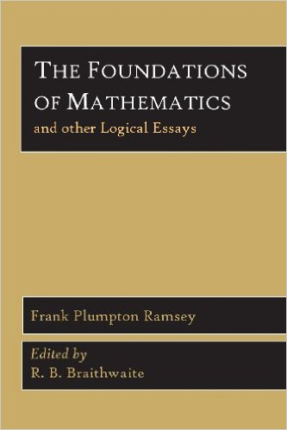
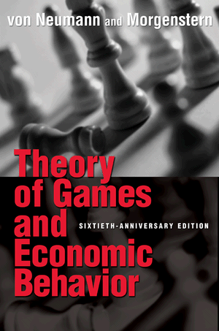
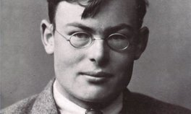
1931
John von Neumann & Oskar Morgenstern
Frank P. Ramsey
1944

Slide 19
Ramsey’s Pragmatism
The essence of pragmatism I take to be this, the meaning of a sentence is to be defined by reference to the actions to which asserting it would lead, or, more vaguely still, by its possible causes and effects.
Facts and Propositions”. Proceedings of the Aristotelian Society, Supplementary Volumes 7 (1927).
Cf. Wittgenstein’s Philosophical Investigations
Man kann für eine große Klasse von Fällen der Benützung des Wortes "Bedeutung" - wenn auch nicht für alle Fälle seiner Benützung - dieses Wort so erklären: Die Bedeutung eines Wortes ist sein Gebrauch in der Sprache.
(PU 43).

Slide 21
Sven Ove Hansson
From the casino to the jungle: Dealing with uncertainty in technological risk management
Synthese (2009) 168:423–432
For a clear example of a decision under uncertainty, consider instead the decision of an explorer whether to enter a distant part of the jungle, previously untrod by human foot. There are tigers and poisonous snakes in the jungle, but no estimates better than guesses can be given of the probability of being attacked by them. Such attacks are known dangers with unknown probabilities. In addition, it is reasonable to expect that the jungle contains unknown species—perhaps insects and microorganisms—some of which may be dangerous. Not only the probabilities but the very nature and existence of these dangers is unknown.
For good or bad, life is usually more like an expedition into an unknown jungle than a visit to the casino. [..] In other words, typical real-life situations are characterized by uncertainty that does not, primarily, come with exact probabilities.
(p. 426)

Slide 22
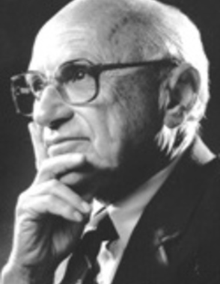
Friedman on Realism and Predictability in Economics
Truly important and significant hypotheses will be found to have "assumptions" that are wildly inaccurate descriptive representations of reality, and, in general, the more significant the theory, the more unrealistic the assumptions (in this sense). The reason is simple. A hypothesis is important if it "explains" much by little, that is, if it abstracts the common and crucial elements from the mass of complex and detailed circumstances surrounding the phenomena to be explained and permits valid predictions on the basis of them alone. To be important, therefore, a hypothesis must be descriptively false in its assumptions.
[T]he relevant question to ask about the "assumptions" of a theory is not whether they are descriptively "realistic," for they never are, but whether they are sufficiently good approximations for the purpose in hand. And this question can be answered only by seeing whether the theory works, which means whether it yields sufficiently accurate predictions. The two supposedly independent tests thus reduce to one test.
The Methodology of Positive Economics (1953)

Slide 23
Taleb’s name dropping
(and that’s only Ch. 11)
Popper
Hayek
Poincaré
Samuelson
Walpole
Bacon
Gamow
Bethe
Glaucias of Tarentum
Pasteur
Koestler
Plato
Semmelweis
Buffet
Keynes
Mandelbrot
Goodman
Dennett
Philnus of Cos
Serapion of Alexandria
Darwin
Du Bois-Reymond
Fleming
Marx
Watson
Galileo
Hilbert
Einstein
Whitehead
…

Slide 24
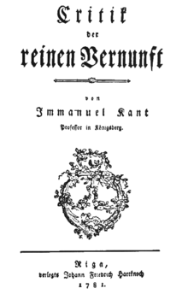
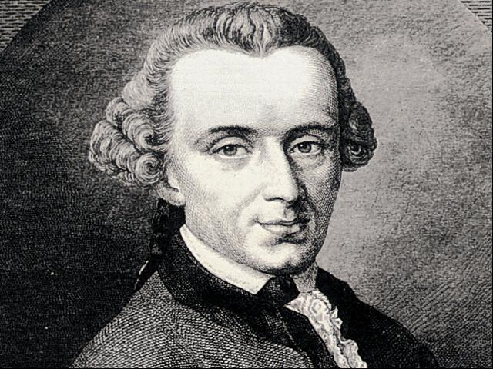
Kant’s Critical Philosophy
Critical philosophy does not necessarily criticize anything.
The aim of critical philosophy is to investigate the limits of human knowledge.
It analyzes the causes and sources of these limits.

Slide 25
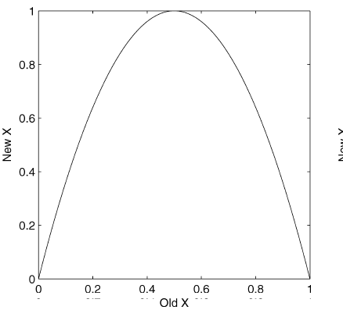
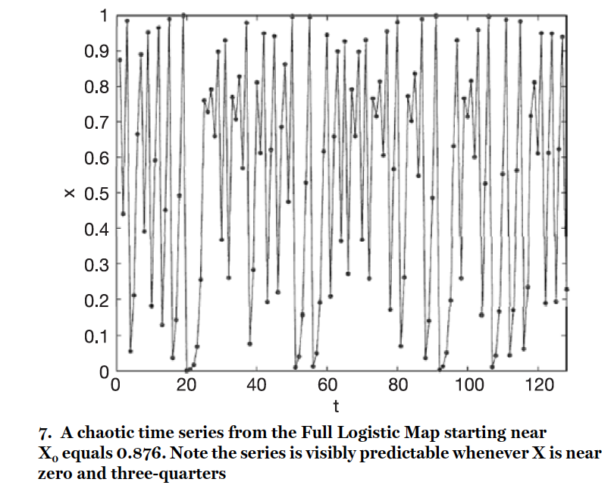
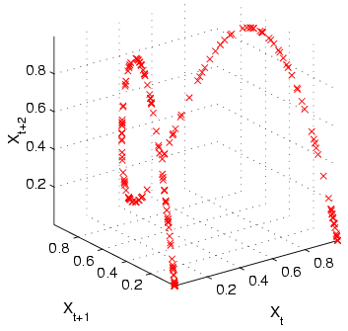
An example for chaos: The logistic map
cf. Smith 2007

Slide 26
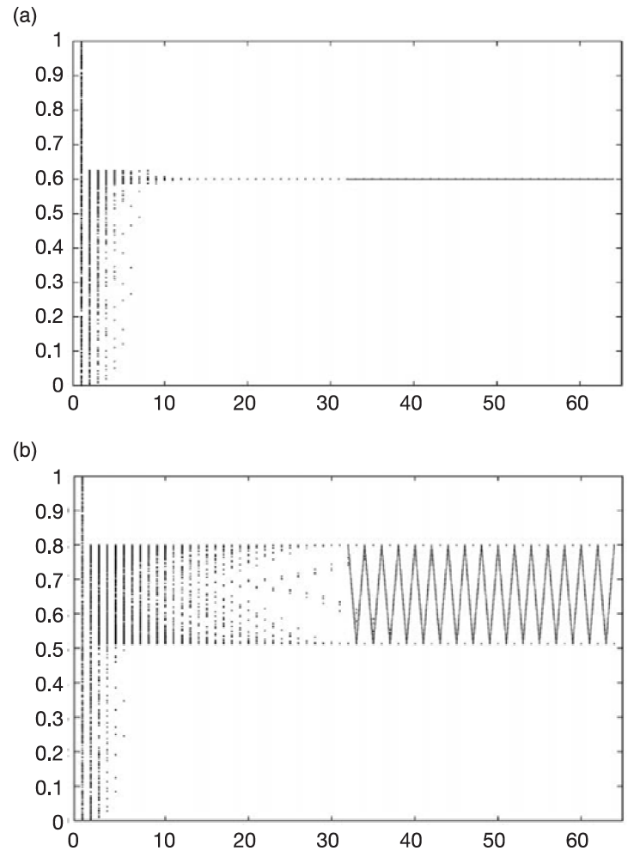
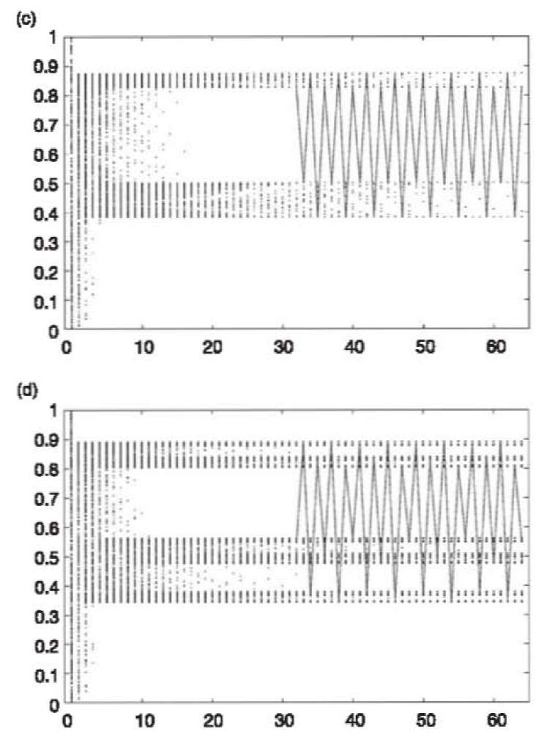
Each frame shows the evolution of 512 points, initially spread at random between zero and one, as they move forward under the Logistic Map. Each panel shows one of four different values of α, showing the collapse towards (a) a fixed point, (b) a period two loop, (c) a period four loop, and (d) chaos. The solid line starting at time 32 shows the trajectory of one point, in order to make the path on each attractor visible. (cf. Smith 2007, p. 48)

Slide 27
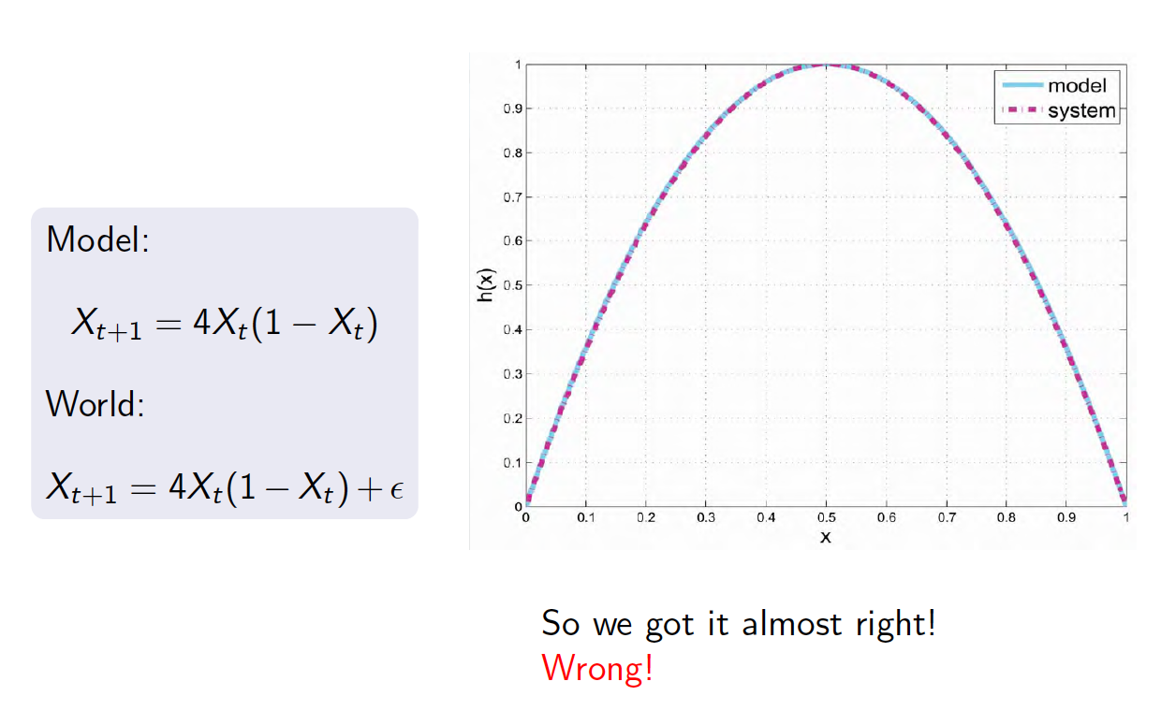
Chaos and Predictability

Slide 28
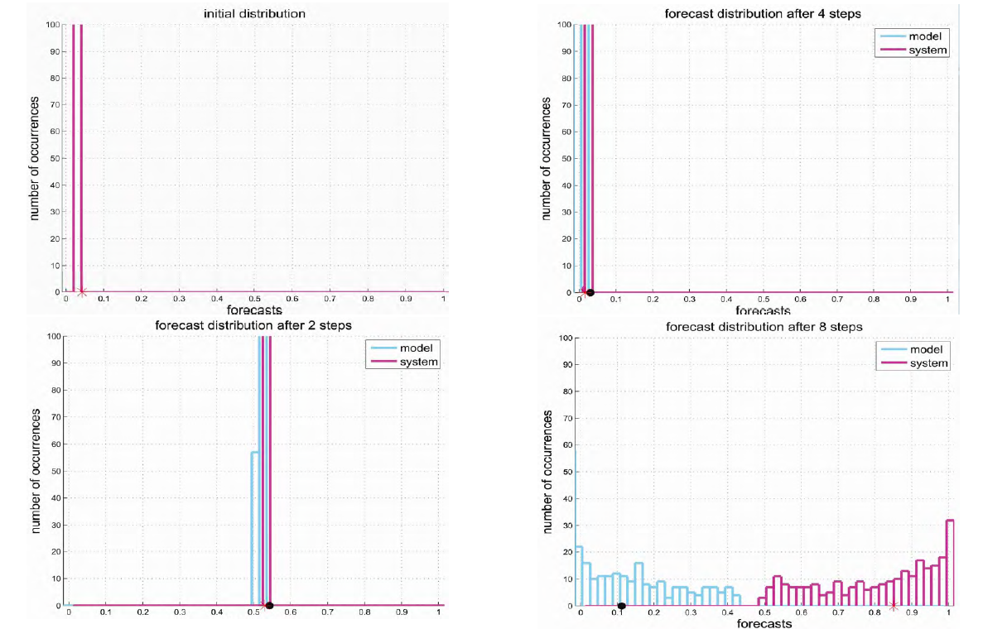

Slide 29
Structural Model Error and Predictability
(cf. Frigg et al. 2014)
Minor errors in our dynamical models can severely limit our ability to predict.
The closeness-to-goodness link does not hold: Even if the model is very close to reality it might give poor predictions.
The butterfly effect can be dealt with by the use of probabilistic tools.
The “hawkmoth effect” puts a more severe limitation on predictability than the butterfly effect.

